Slide 1
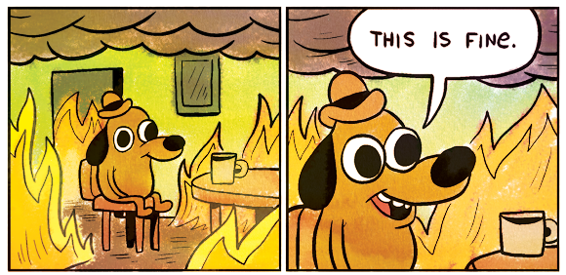
Climate Change
A story in
two acts:

Slide 2
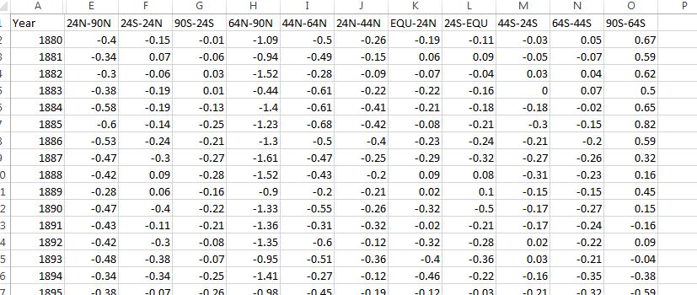
Climate Anomalies
Data Sources:
Global surface temperature anomalies from 1880-2017 by zone (https://data.giss.nasa.gov/gistemp)
List of national capitals https://en.wikipedia.org/wiki/List_of_national_capitals_by_latitude
https://twitter.com/anttilip/status/1033342041474969601?s=03

Slide 3

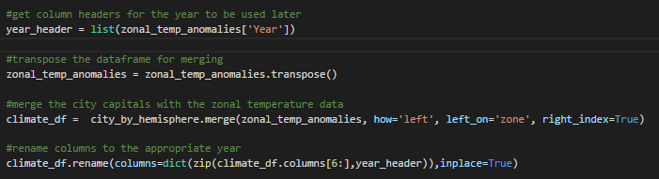
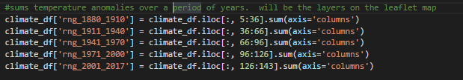
Climate Anomalies
Code
Highlights
Determine the zone based on Latitude
Had to transpose the dataframe and rename the 120 + columns to the respective year before merging
Created ranges by summing multiple columns. The were used as the layers on the map

Slide 4
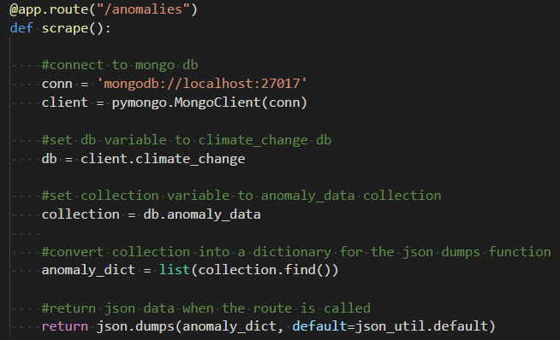
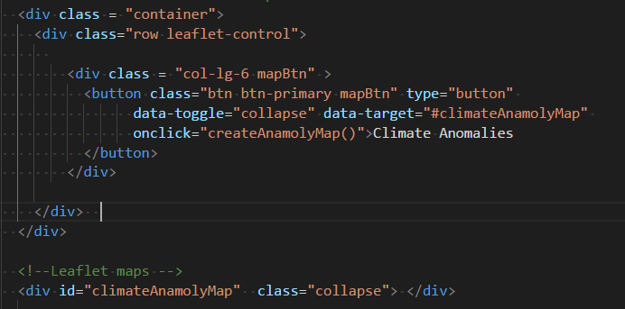
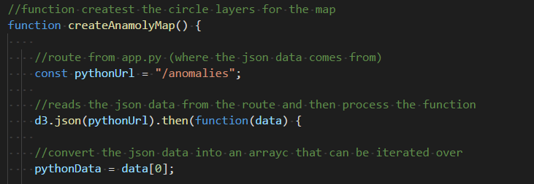
Climate Anomalies
http://127.0.0.1:5000/

Slide 5
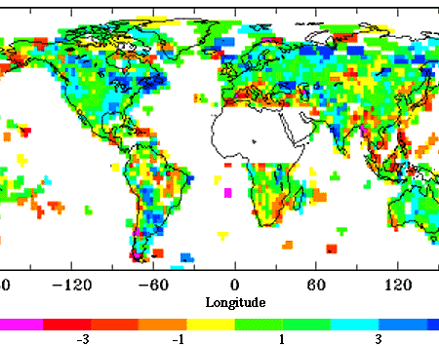
Precipitation
As humidity increases, water vapor
increases in the air.
Creating an increase chance of
rainfall.
The data from 1900-1988, shows that
temperature changes occur at night
then during the day time.
www.nasa.gov

